Slide 1
Phase 2
Charlie
David Crow
Savannah Hyde
Ahmed King

Slide 2
Group Steps to Complete Deliverable
Enumerate steps taken by group to accomplish deliverable
David: WORadarSensor (hyperplanes, sensor logic), lambda functions, overall cleanup
Savannah: Interceptor logic, object creation, callback forwarding
Ahmed: Keypresses, config file input and update, strategy pattern, object subscription
Issues
Individuals didn’t [initially] have enough knowledge to properly implement their own subsystem within greater system
Unawareness of key features (lambda functionality, plane rotation)

Slide 3
Design Decisions
Software quality attributes
No significant design decisions – simply implemented provided methods
Most important software quality: readability – primarily worked remotely
Design patterns
Strategy pattern – program can easily be expanded to perform more complicated motion

Slide 4
Lessons Learned
What worked?
The simple stuff
What did not?
Hyperplane math
Trigonometry
If you could send a message back through time, what would you tell your group?
Rotating the visual wedge does not rotate the sensed area
The filter function converts an object’s position to distance, heading, and azimuth relative to the sensor

Slide 5
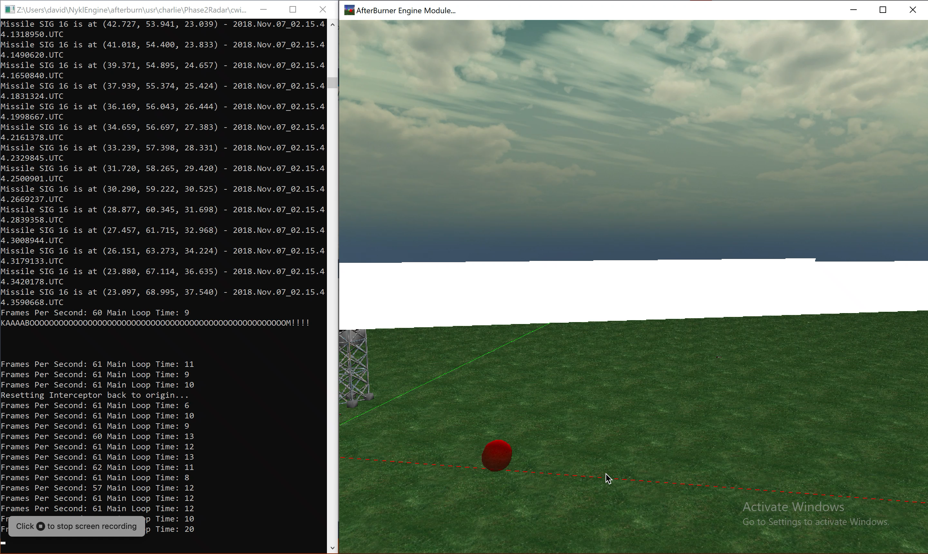
Images of Functionality / Performance Analysis

Slide 6
Team Hours and Morale
Lt David Crow: high morale
2 hours implementing WORadarSensor
2 hours for lambdas and cleanup
2 hours debugging object sensing
Lt Savannah Hyde: high morale
2 hours creating objects and forwarding callbacks
1 hour implementing interceptor logic
1.5 hours attempting lambda functions
Lt Ahmed King: high morale
1.5 hours implementing functions in DefenseDaemon
2 hours fixing Git issues, debugging, and reviewing code

Slide 7
Questions?

Slide 8
Grading
57.5/60
Functional Reqs ( 18 / 18 )
Commands
Key presses performed properly
Parses config and updates as expected
Design
Callbacks / lambdas function as expected
Spherical vs non-spherical
Polar coordinate conversion functions properly
Good collision detection
Code Quality / Style / Software Attributes ( 16 / 18 )
-1 Compiler warning: glviewdefensedaemon.cpp(407): warning C4244: '=': conversion from 'double' to 'T', possible loss of data
-0.5 Employ Vector::getTheta, getPhi methods for polar decomposition of Vectors
Good job correctly implementing math for collision detection / point inclusion.
Git Logs / Group Work ( 12 / 12 )
Git comments explain corresponding work
Savannah only had one commit, but showed lots of work. Was all this one chunk?
Presentation ( 11 of 12)
Conveyed development process successfully
Demo was good, quantitative results shown in ppt.

